Slide 1

Shining Light on Heart Matters
Sybrand E. Smit
Notes:
Good day, fellow heart lovers. Thank you for joining me to ‘shine some light on heart matters’ this morning. With winter fast approaching, I thought it well for us to delve a bit into the benefits of sunlight, so we may remember our good friend, “The Sun”, lazing away in bed watching sports and series, or even while we are busy dealing with the struggles of indoor hard labour and admin.
http://www.eczemasymptoms.org/wp-content/uploads/2014/10/sunlight-vitamin-d.jpg

Slide 2
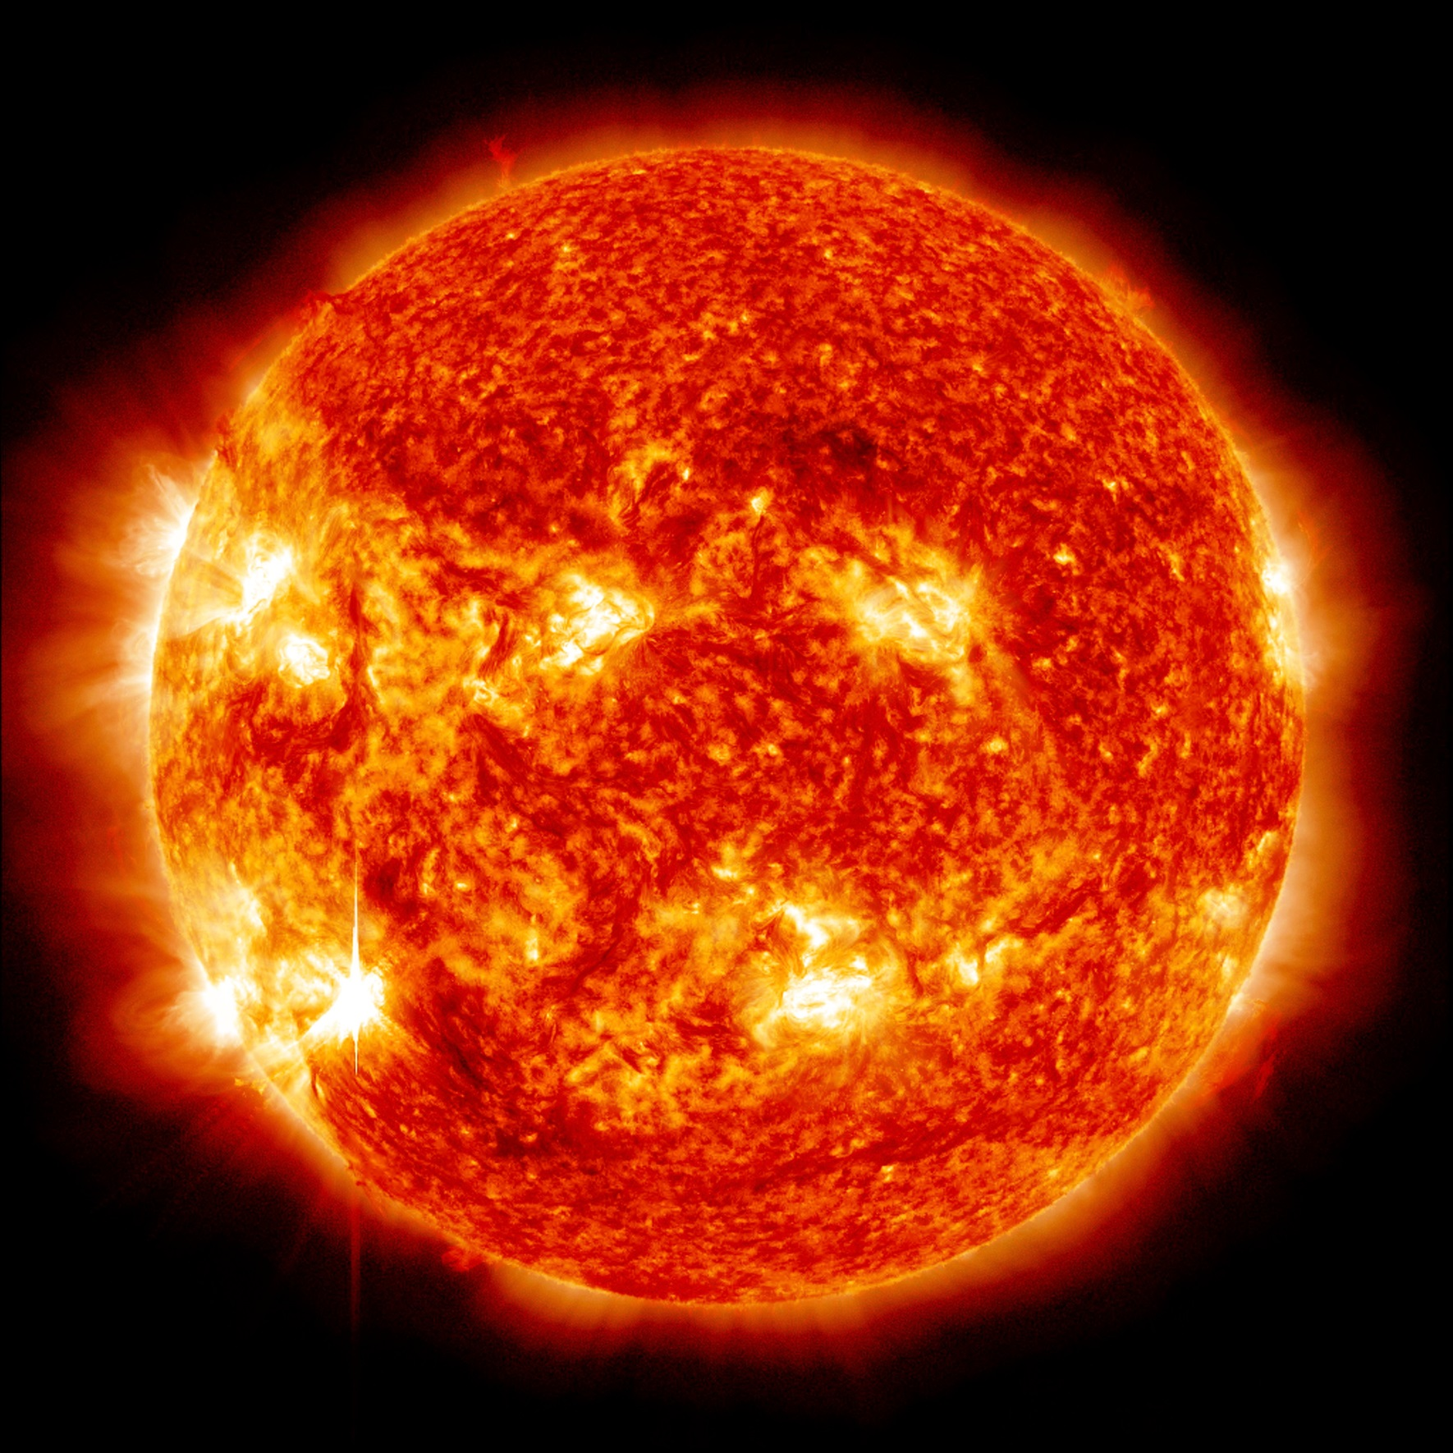
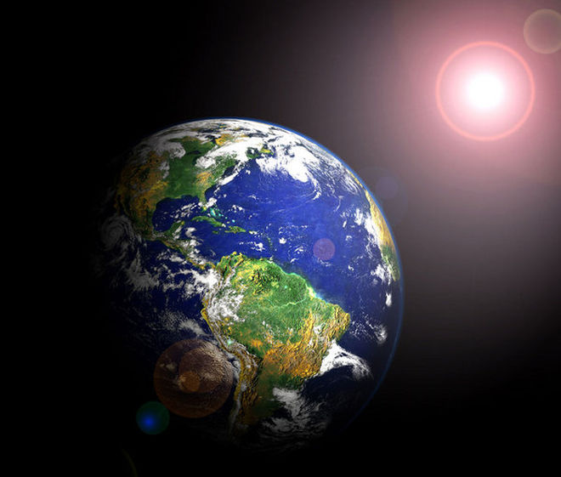

8 minutes
150 000 000 km
Notes:
Now, the sun might look all cute and innocent at a 150 MILLION kilometers away as fresh rays flow *CLICK* over us here on earth every 8 minutes, BUT *CLICK* let us not forget the pure awesomeness of its creative purpose.
http://www.livescience.com/images/i/000/031/089/original/earth-orbit-sun.jpg?interpolation=lanczos-none&fit=inside%7C660:*
https://www.nasa.gov/sites/default/files/706436main_20121114-304-193blend_m6-orig_full.jpg
https://upload.wikimedia.org/wikipedia/commons/a/a7/Earth_-_Africa,_Middle_East_and_Europe_(16728031541).jpg

Slide 3
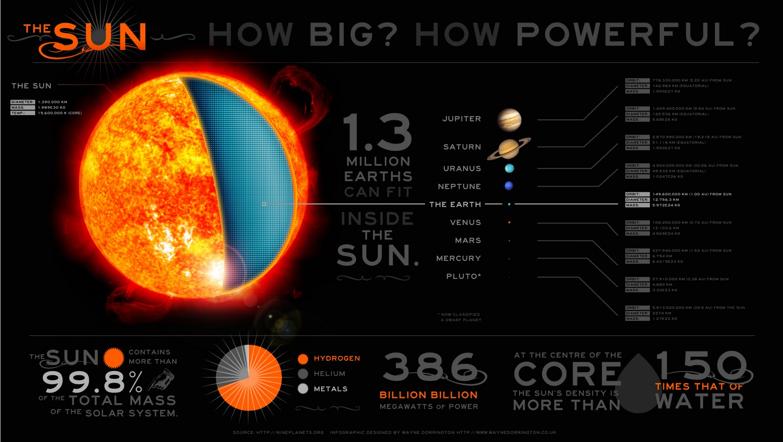
Notes:
The sun is not just at the centre of our solar system, it basically *CLICK* IS the solar system constituting 99.8 % of its effective mass. Furthermore, the power output of the sun *CLICK* equates to an estimated 386 billion billion megawatts of power... to put this figure in perspective
http://1.bp.blogspot.com/-J4o8q1RTSIw/TVvwH_nVxLI/AAAAAAAAAFo/Q_qw-5YZ2TM/s1600/the_sun.jpg

Slide 4

100 billion x 1 megaton nuclear bombs
Notes:
if we ever reach the point where we want to try and destroy the sun, it would require the equivalent of 100 billion 1 megaton nuclear weapons to overcome the sun’s output, which is a project you just simply WILL not get grant money for.

Slide 5
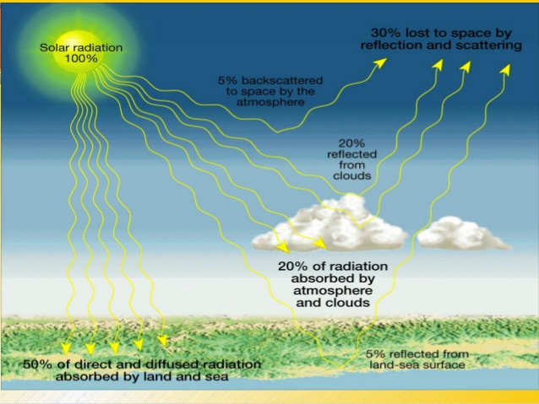
Notes:
Now it is important to note that of all the sun rays making its way to earth, only about half reach and are absorbed by the earth’s surface, whereas the rest are either reflected by the atmosphere and clouds or absorbed by these entities.
Furthermore, how closely you are situated to the equator will also determine how much solar radiation you receive. That being said, a mere 70 minutes of sun exposure on earth is sufficient to supply all of the global energy consumption per year!
http://image.slidesharecdn.com/phesch17atmosphere-150612130823-lva1-app6892/95/prentice-hall-earth-science-ch17-atmosphere-21-638.jpg?cb=1434114651

Slide 6
Notes:
On an environmental note... Solar farms the size of Namibia would be required to fully rely on solar power to meet the current global energy demand.
http://www.beautifulworld.com/images/maps/africa/namibia-africa-map.jpg

Slide 7

Benefits of Sunshine
Notes:
Okay, so we all know the sun is important for life on earth. But physiologically how does it affect you and me?
http://www.nutritionsecrets.com/wp-content/uploads/2015/04/Feature3_image2_vitD.jpg

Slide 8
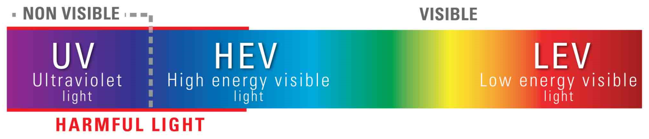
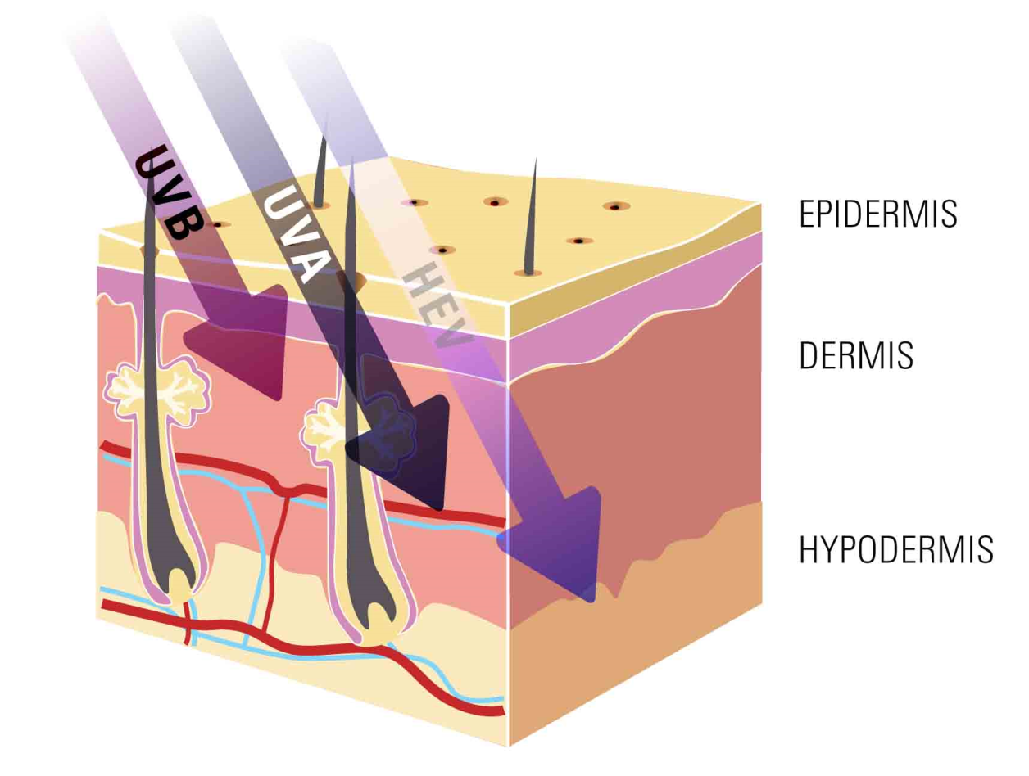
Notes:
First of all, let me clarify the word ‘sunlight’. Sunlight or solar rays are broken up into 4 types, ultraviolet A, ultraviolet B, ultraviolet C (which is completely reflected by the earth’s atmosphere) and high energy visible light. The longer the wavelength of these waves, the deeper they penetrate into human skin.
http://zo-skinhealth.co.uk/wp-content/uploads/2015/05/HEV-light.jpg

Slide 9
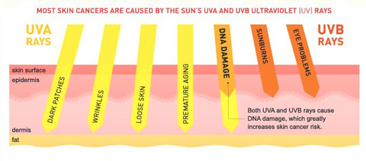
Notes:
Now, on the detrimental side of sunlight resulting from OVERexposure, the general consensus is that the duller UVA rays are contributors of skin ageing and wrinkles, whereas the brighter UVB is responsible for sun-burning and eye damage when sun-exposure exceeds daily recommendations without protection. Also, excessive exposure to both these rays can lead to DNA damage and progress to skin cancer. However, when moving past the hype of skin cancer, sunlight has numerous proven beneficial effects, which include:
http://cdn.shopify.com/s/files/1/0535/8233/files/UVAUVB_large.jpg?8580

Slide 10
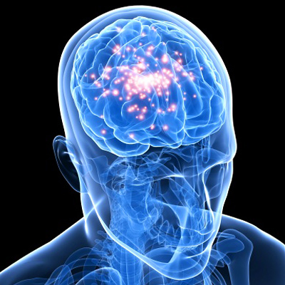
Releases Serotonin
Notes:
Exposure to sunlight is thought to increase the brain’s release of a hormone called serotonin, through stimulating special areas in the retina. This is associated with *CLICK* boosting overall mental health, mood and helping a person feel calm and focused. Without enough sunlight exposure, a person’s serotonin levels can dip and are associated with a higher risk of seasonal affective disorder (or SAD), a form of depression triggered by changing seasons.
http://laughteryoga.org/uploads/cms/original/564b03ce9116bserotonin.jpg

Slide 11

Notes:
Exposure to sunlight is thought to increase the brain’s release of a hormone called serotonin, through stimulating special areas in the retina. This is associated with *CLICK* boosting overall mental health, mood and helping a person feel calm and focused. Without enough sunlight exposure, a person’s serotonin levels can dip and are associated with a higher risk of seasonal affective disorder (or SAD), a form of depression triggered by changing seasons.
http://cdnstatic.visualizeus.com/thumbs/34/be/happy,kids,nature,photography-34bede45435e99a9204a563c0b191c2b_h.jpg

Slide 12
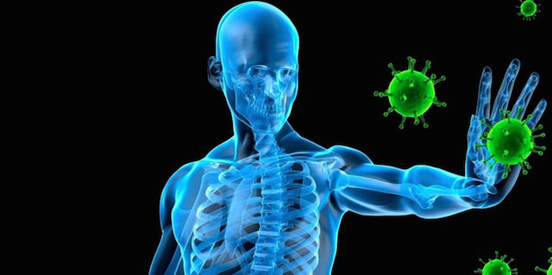
Strengthens Immunity
Notes:
UVA and UVB radiation from the sun can also prompt the release of T-regulatory cells, which attack self-regulated T-cells and ultimately boost your immune system. Furthermore, alpha-melanocytes release are also triggered which reduces the risk for melanomas by increasing gene repair; and triggering of neuropeptide substance P release can result in local immune suppression.
http://www.wakingtimes.com/wp-content/uploads/2015/06/Immunity.jpg

Slide 13
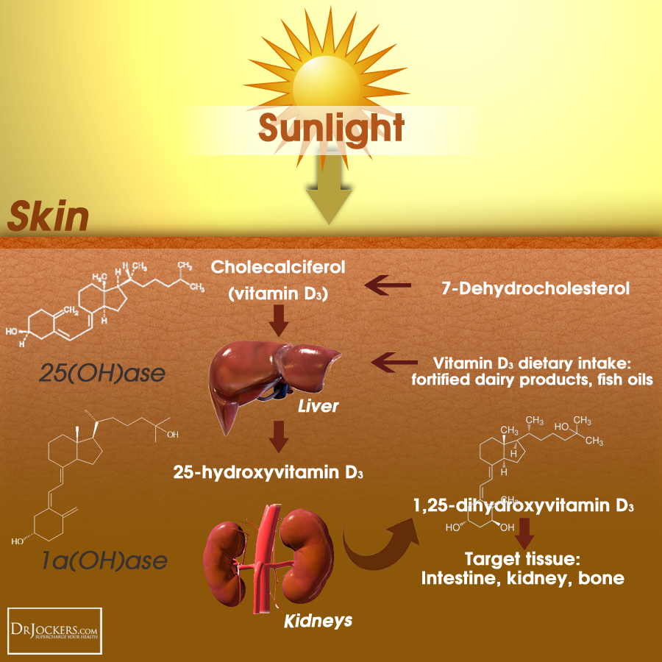
Notes:
Other than serotonin and effects on immunity, the main mechanism through which sunlight elicits beneficial responses is through the production of vitamin D.
http://333oee3bik6e1t8q4y139009mcg.wpengine.netdna-cdn.com/wp-content/uploads/2013/07/VitaminD_SunInfoChart2.png

Slide 14
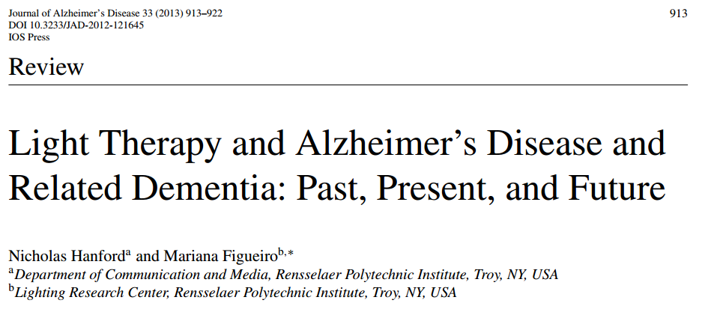
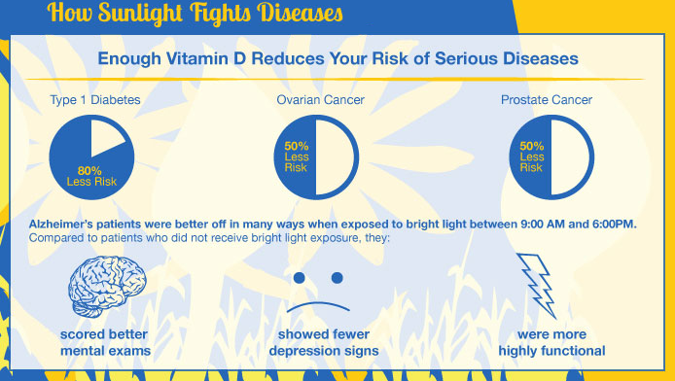
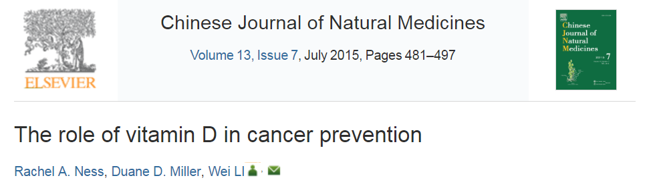

Notes:
Balanced vitamin D levels has been independently shown to reduce risk for Type 1 diabetes mellitus *CLICK* by an estimated 80%, as well as reducing the risk for *CLICK* ovarian and prostate cancer by 50%. Also, in various studies to date, vitamin D and light treatment *CLICK* have been met with clinical favourable outcomes in Alzheimer’s and related dementia patients with regards to mental performance, increased activity levels and overall better prospects.
http://carrington.edu/wp-content/uploads/2012/03/Sunlight-Info-graphic.jpg

Slide 15



Notes:
So, how much sun is enough sun? Unfortunately, there is no clear-cut definition and the amount of sun-time varies based on location, type and time of day, as well as your skin tone. Based on our skin tone, we can be classified into 6 different categories ranging from *CLICK* an Anne Hatheway or Type 1 Skin tone, all the way to *CLICK* an Idris Elba or Type 6 skin tone.
http://www.planetsun.ca/wp-content/uploads/2013/04/tan-smart.jpg
http://www.speakerscorner.me/wp-content/uploads/2016/01/anne3.jpg
http://d236bkdxj385sg.cloudfront.net/wp-content/uploads/2012/02/idris.png

Slide 16
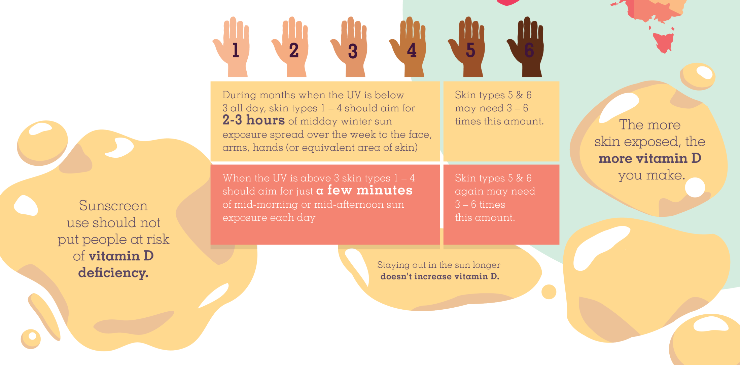
Notes:
Therefore, depending on the amount of pigmentation in your skin, you will be acquiring 2-3 hours of sun light per week during winter months and 15 minutes a day on summer days if you are fair skinned, while, if you are darker skinned, you will require upto 6 times this amount of sun time to produce sufficient vitamin D. Also note that the more skin you have exposed, the more vitamin D you will produce, however once you have reached your daily recommendation, no further increase in vitamin D production can be achieved.
http://www.cancertas.org.au/wp-content/uploads/2014/03/SunSmart-infographic.png

Slide 17
Other benefits of sunlight?
Notes:
Given the known beneficial effects of sunlight, the question arises “What other benefits do sunlight possess? And can it reach where it doesn’t shine?”

Slide 18
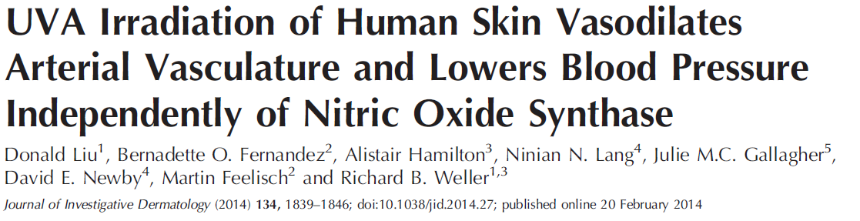
Notes:
To deepen our understanding into this matter, I found this article by Liu and Colleagues published in 2014, where they were interested in the effects of sunlight on blood pressure, which happen independently from Vitamin D production.

Slide 19

Blood Pressure Explained
Notes:
To quickly refresh our understanding of blood pressure I want to play this short clip..
So, the take-home message is the higher your blood pressure, the harder your heart has to work to circulate blood through the body (and thus the more pressure needs to be exerted by your heart).
Blood Pressure Animation | Heart disease risk factors
Heart Foundation NZ
https://www.youtube.com/watch?v=sOwBDmu1Y0c

Slide 20
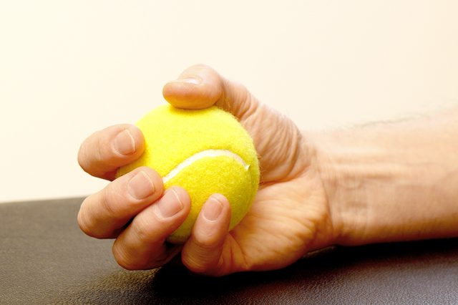
Notes:
To give an idea of how much pressure is exerted by the heart, I found this illustration stating that the force at which the heart pumps is equivalent to the force you can exert squeezing a tennis ball as firmly as possible.
http://img.aws.livestrongcdn.com/ls-article-image-640/cme/photography.prod.demandstudios.com/c81b1a6a-3ba5-4e0c-a4ec-2fbd624f3b84.jpg

Slide 21
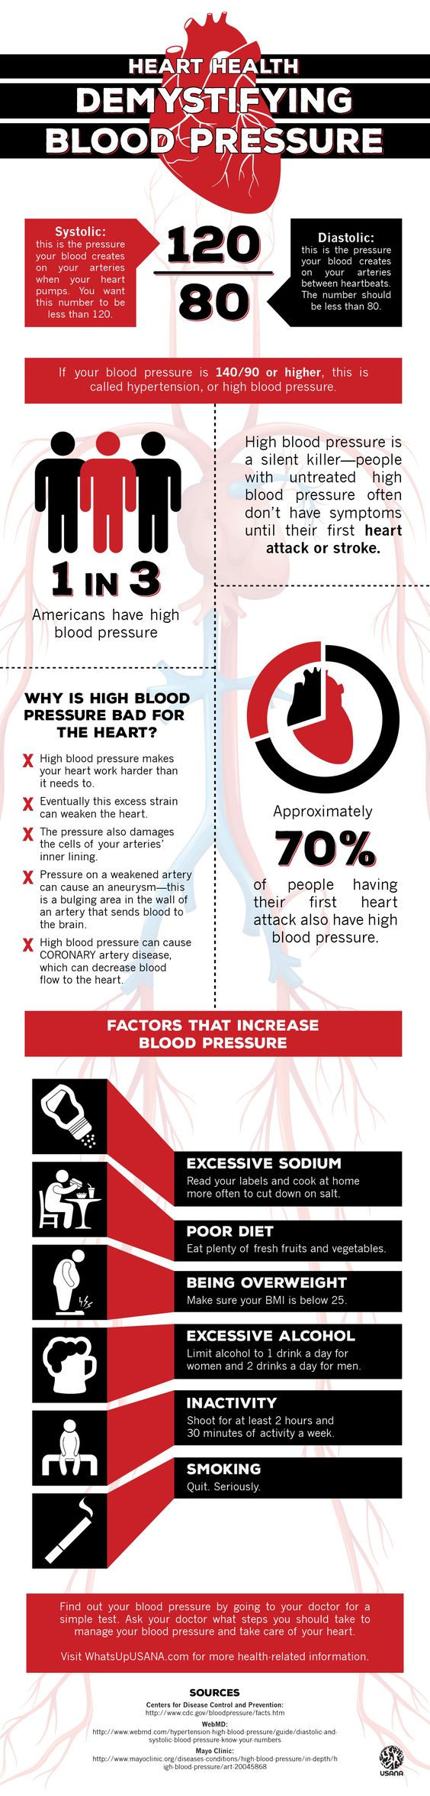
Notes:
Now, high blood pressure is known as the ‘silent killer’ as people with high blood pressure often show no symptoms of the conditions until it manifests in a heart attack or stroke.
*CLICK* Furthermore, 70% of patients having their first heart attack also present with high blood pressure.
*CLICK* and we have identified various risk factors that contribute to a rise in blood pressure, summarised as too much salt, processed food, too much extra weight, too much alcohol, too much laziness and lastly, too much smoking :)
https://za.pinterest.com/pin/248823948138604588/

Slide 22
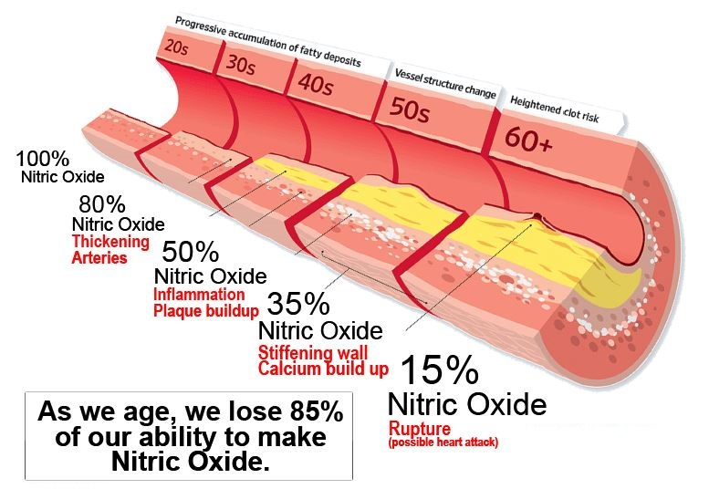
Notes:
Another contributor is also ageing, which is tied to a decrease in nitric oxide production. Now as people age, the heart tends to enlarge slightly, developing thicker walls and slightly larger chambers. The increase in size is mainly due to an increase in the size of individual heart muscle cells. The walls of the arteries and arterioles become thicker, and the space within the arteries expands slightly, making the vessels stiffer and less resilient.
http://www.athletespoweredbyno.com/wp-content/uploads/2014/07/Nitric-Oxide-Production-as-We-Age-Scott-Norton.jpg

Slide 23
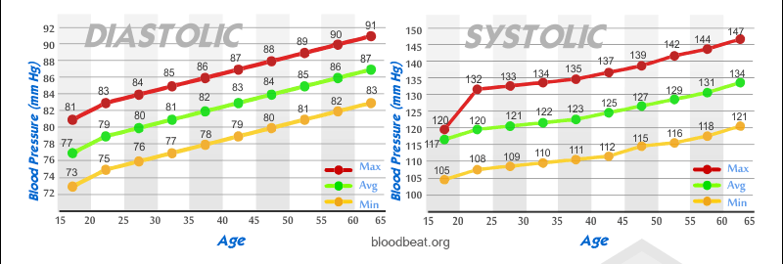
Notes:
Because arteries and arterioles become less elastic as people age, they cannot relax as quickly during the rhythmic pumping of the heart. As a result, blood pressure increases more when the heart contracts than it does in younger people.

Slide 24
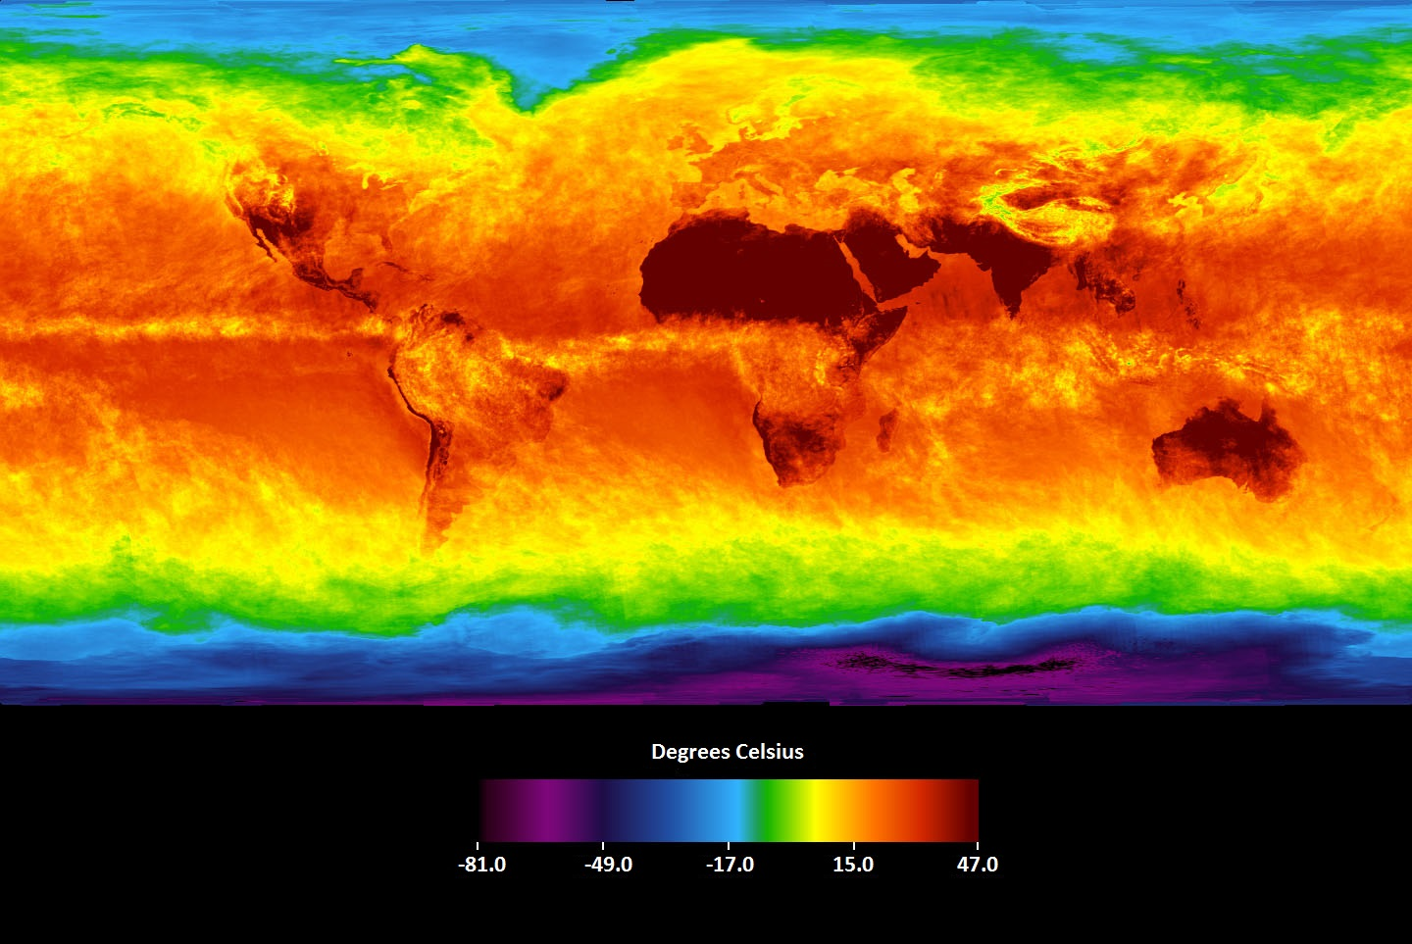
Notes:
As an added contributor of high blood pressure, in the present study they have noted that during wintertime in European nations, blood pressure tends to rise significantly in the general population and this is arguably due to the decrease in ultraviolet ray intensity reaching these nations during the cold and cloudy European winters.

Slide 25
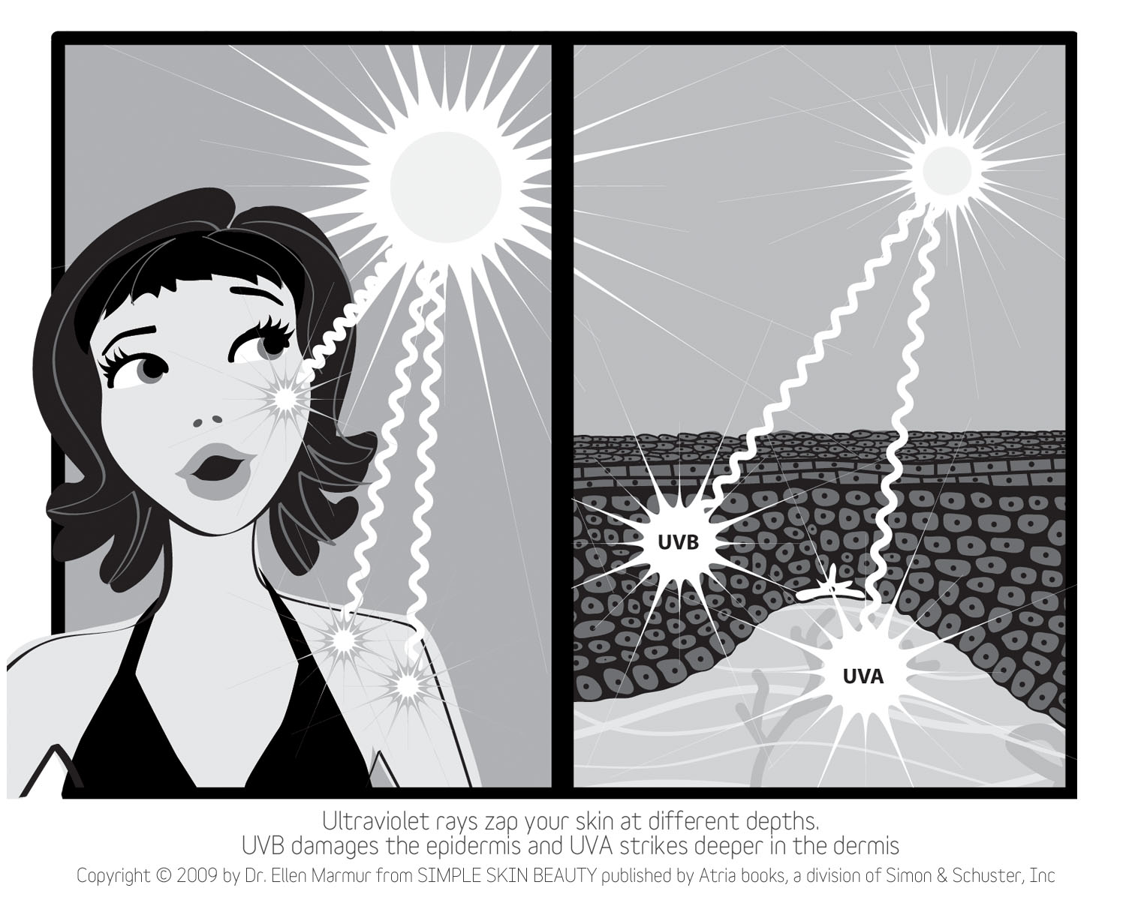
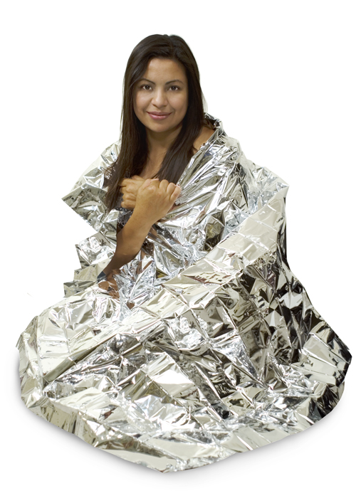
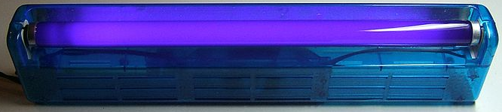
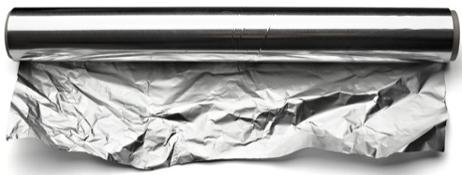
24 Healthy Volunteers
20cm
UVA
HEAT
Notes:
So, in order to investigate the effect of whole-body UVA irradiation on blood pressure, they recruited 24 healthy human volunteers (18 men and 6 women all aged 22 years, ranging from skin type 1 to 6) and randomly assigned them into *CLICK* a group receiving UVA radiation for 20 mins or a group receiving only the radiant heat from the UVA light source, which was controlled by covering volunteers *CLICK* with a metal foil ‘space blanket’ during irradiation, which allowed the temperature rise induced by the lamp, but prevented UVA irradiation reaching the skin.
http://thespiritscience.net/wp-content/uploads/2015/09/aluminum-foil.jpg
http://www.huidziekten.nl/afbeeldingen/illustraties/woods-lamp-UVA.jpg

Slide 26
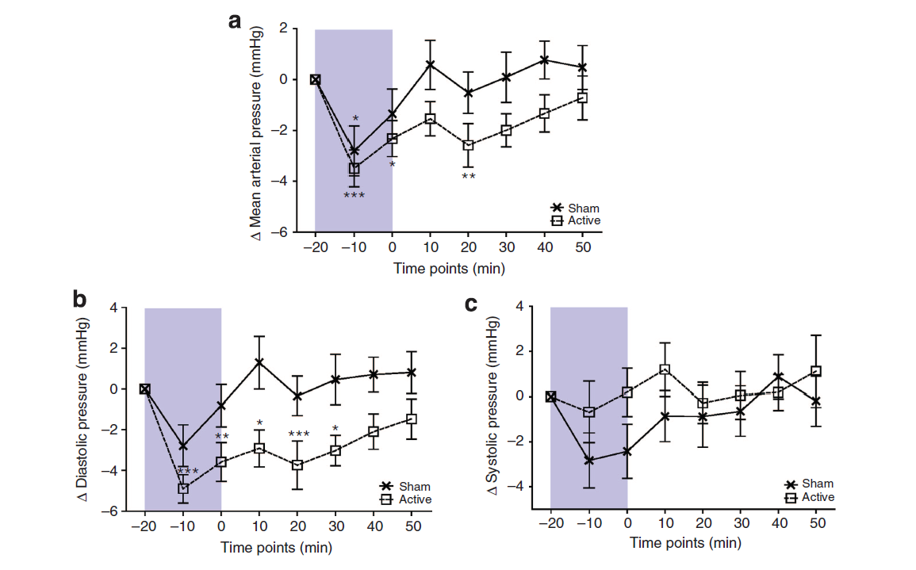
Blood Pressure
Notes:
During and for 20minutes after active irradiation, *CLICK* the mean arterial pressure fell significantly in the UVA treated group. Sham irradiation caused a transient fall in mean arterial pressure only during irradiation, suggesting an additional temperature effect. Diastolic Blood Pressure *CLICK* fell by 5 millimeter mercury during active irradiation and was sustained for 30minutes. These changes were also greater in the active than sham-irradiated group. Sham irradiation caused a slight, but nonsignificant reduction in diastolic blood pressure of 3 mm mercury. Systolic BP *CLICK* showed no change from baseline with either exposure.

Slide 27
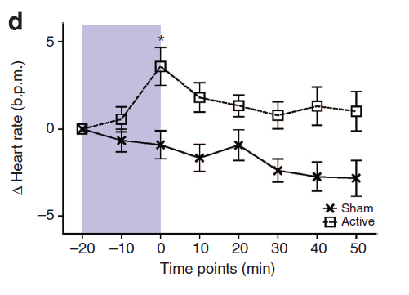
Heart Rate
Notes:
Accompanying the drop in blood pressure, heart rate rose significantly by 3 to 4 beats following active UVA radiation, but fell slightly during and after sham irradiation; the difference between groups was highly significant.

Slide 28
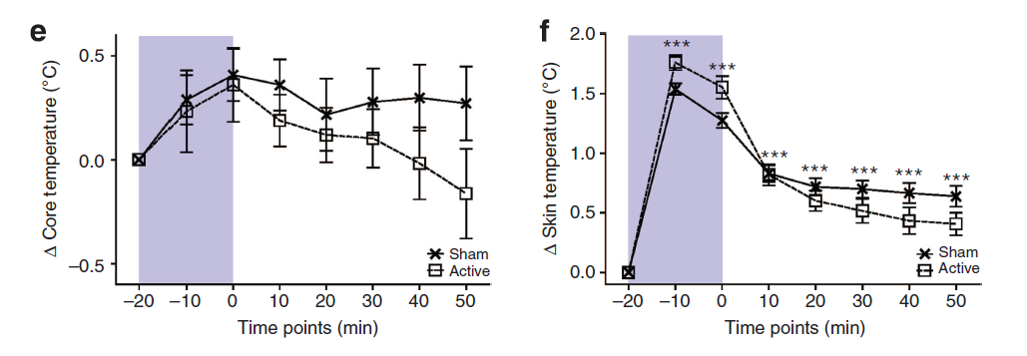
Body and Skin Temperature
Notes:
Sham and active UVA irradiation groups showed a similar rise in core temperature *CLICK* of 0.5 degree Celsius immediately after irradiation, which represented a significant change from baseline. Core temperature gradually returned to baseline after active irradiation, but remained slightly elevated in the sham group. Skin surface temperature *CLICK* rose by 1.5 and 1.8 degrees celcius in sham and active irradiation groups, respectively, and returned similarly toward baseline after irradiation.

Slide 29
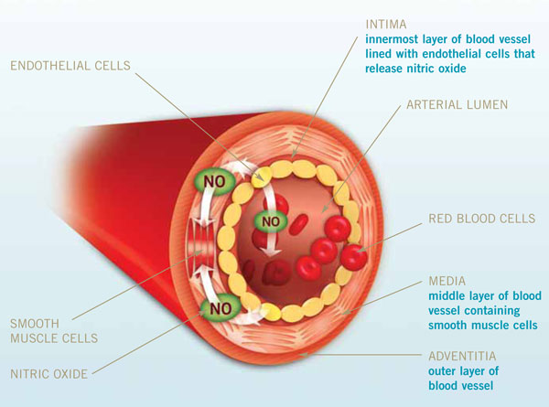
Notes:
In order to derive how UVA lowers blood pressure, they investigated the role of the nitric oxide mobilization from cutaneous stores into the systemic circulation. First recall that nitric oxide is responsible for inducing relaxation in blood vessels when released from the endothelial cell lining. However, the production of nitric oxide rests heavily on the availability of its metabolites, nitrate, nitrite and nitroso-thiols. It has been shown that the concentration of nitric oxide metabolites, such as nitrate are upto 3 times higher in the dermis and epidermis of skin than in circulation, which means these metabolite stores are just waiting for the appropriate stimulus to trigger excretion into systemic circulation.
https://www.google.co.za/url?sa=i&rct=j&q=&esrc=s&source=imgres&cd=&ved=0ahUKEwih1IT6qN7MAhUSahoKHWp1DikQjBwIBA&url=https%3A%2F%2Fwww.nia.nih.gov%2Fsites%2Fdefault%2Ffiles%2Fnia-aha_image37_large.jpg&psig=AFQjCNGUD-SkpkJvCJlei8KWtWScqw2CsQ&ust=1463478603099868

Slide 30
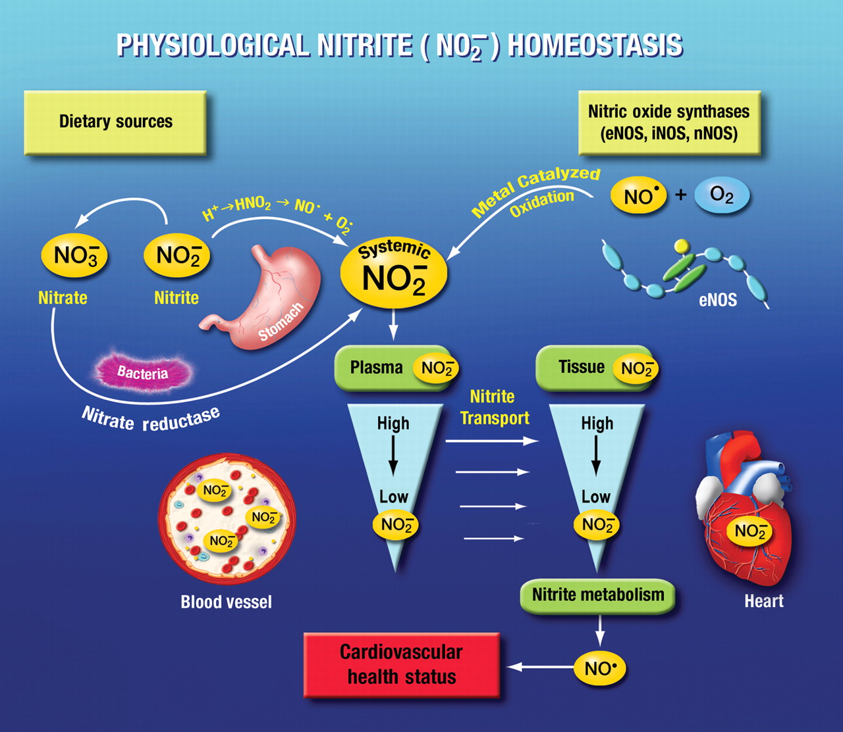
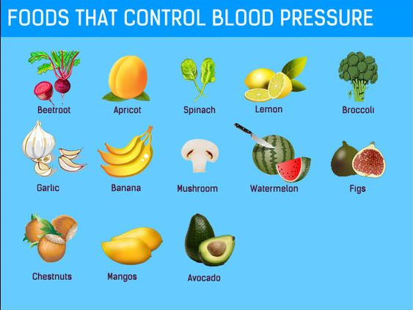
Notes:
So, in general we get our nitrates and nitrites from dietary sources *CLICK* such as leafy vegetables, beetroots, garlic, et cetera. where *CLICK* nitrate is either absorbed into the blood through the salivary glands, or reduced by bacteria in the oral cavity to nitrite. Within the stomach acid, nitrite is further reduced non-enzymatically to nitric oxide. Nitrate and the remaining nitrite is also absorbed in the intestine into systemic blood circulation where it forms nitric oxide.
https://d2npw7jqx38emt.cloudfront.net/content/cardiovascres/83/2/195/F2.large.jpg
https://za.pinterest.com/pin/439593613604296006/

Slide 31
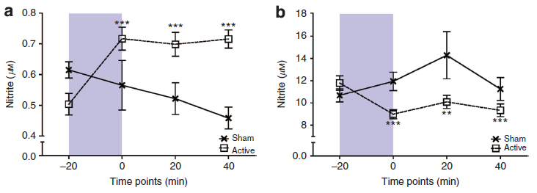
Nitrite (NO₂⁻) and Nitrate (NO₃⁻)
Nitrite (μM)
Nitrate (μM)
Notes:
So, to minimize fluctuations in circulating NO metabolite levels by dietary intake, variation study subjects (I’m not quite sure what is meant by ‘variation study subjects’. My guess is some did, while others didnt? Nyeah) so, these groups consumed a low nitrite/nitrate diet for 2 days before further mechanistic study. Under these conditions, nitrite *CLICK* increased from 0.50 mM pre-UVA to 0.72 mM immediately after irradiation and remained elevated at 0.72 mM for 40 minutes after irradiation. A nonsignificant trend toward lower circulatory nitrite levels was observed during sham irradiation.
These changes seemed to occur at the expense of nitrate *CLICK*. Circulatory nitrate fell significantly from 12 to 9 mM and remained below baseline at 9 mM 40 minutes AFTER ACTIVE irradiation only.

Slide 32
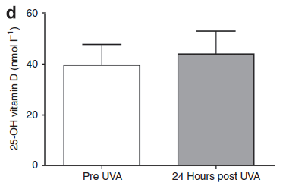
Vitamin D
Notes:
No significant changes were observed in plasma vitamin D levels following active or sham irradiation, and they argued the delayed minor rise in vitamin D may be due to the small UVB contribution from their UVA source.

Slide 33
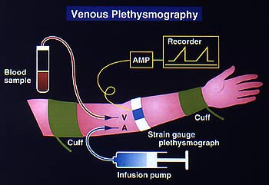
Notes:
In the final aim of the study the researchers were interested in the effects of UVA on forearm blood flow in the absence of nitric oxide synthase. Again, they recruited 12 healthy male volunteers, split them into 2 groups with half receiving an infusion of the nitric oxide inhibitor (L-NMMA), which blocks NOS-derived nitric oxide production, while the other half received no infusion. The forearm blood flow was measured using a venous occlusion plethysmograph. The volunteers repeated the procedure on two separate days, once for UVA radiation and the other for sham (or temperature control) treatment.
http://www.j-circ.or.jp/english/sessions/reports/64th-ss/figures/shimokawa-4l.jpg

Slide 34
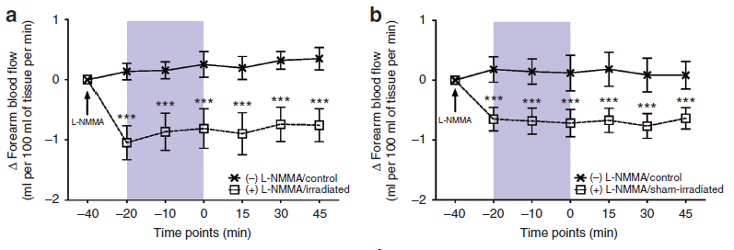
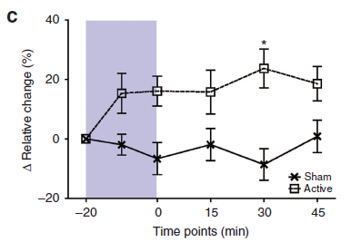
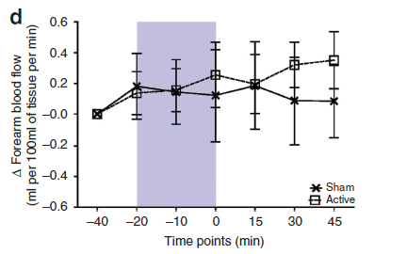
Notes:
Infusion of the NOS inhibitor L-NMMA *CLICK* UPstream of the vascular bed under study caused a fall from baseline of FBF within 20 minutes. This was sustained throughout the protocol during sham and active irradiations, but did not affect FBF in the non-infused, contralateral arm. UVA irradiation of the L-NMMA-infused arm *CLICK* caused local vasodilatation, with robust elevation of forearm blood flow over the L-NMMA baseline 30 minutes after irradiation. No effects on FBF were observed with sham irradiation, and *CLICK* no changes whatsoever occurred in the unirradiated contralateral arm.

Slide 35
Discussion of BP Results
UVA exposure
= ↓ mean arterial blood pressure
= ↓ diastolic blood pressure
= constant systolic blood pressure
↓10mmHg diastolic blood pressure
= 2 X better outcome for CVD and Cerebrovascular Mortality
↓5mmHg diastolic blood pressure
= 34% ↓ risk for stroke
= 21% ↓ risk for coronary heart disease
Notes:
All right, so to tie everything together. The researchers found that:
UVA exposure to one side of the body (equating roughly to a skin surface area exposed when wearing a short-sleeved shirt and shorts) leads to a small but significant fall in mean arterial blood pressure. Mean arterial and diastolic blood pressure fell following irradiation, but systolic blood pressure did not change. Diastolic blood pressure is a function of total peripheral resistance, and its marked drop in actively irradiated subjects, despite the compensatory rise in heart rate suggests that UVA vasodilates the peripheral vasculature.
The relatively small blood pressure changes observed may appear to be of minor significance, but a 10mm mercury change in diastolic blood pressure is responsible for a 2-fold change in cardiovascular or cerebrovascular mortality, whereas a reduction in diastolic blood pressure by 5mm mercury decreases risk for stroke by 34% and coronary heart disease by 21%. In general, any amount of blood pressure reduction is protective against stroke and cardiovascular mortality.

Slide 36
Discussion of NO Results
NO metabolites abundant in skin
regulates blood pressure
UVA exposure transfer nitrite from the skin to circulation, lowering blood vessel tone
NO from the skin is an underestimated contributor to cardiovascular health
Notes:
Also, nitric oxide metabolites is abundant in the skin. When exposed to sunlight, small amounts of nitric oxide are transferred from the skin to the circulation, lowering blood vessel tone.
This effect involves pre-formed stores of nitric oxide in the upper layers of skin.
In this regard, nitric oxide release from skin is a vastly overlooked contributor to cardiovascular health.

Slide 37
TAKE HOME MESSAGE
Benefits of exposure to sunlight POTENTIALLY outweigh the risks of skin cancer
UVA rays alter levels of nitric oxide in the body
causing blood vessels to dilate and reduce blood pressure.
As blood pressure drops, so does the risk of heart attacks and stroke.
Further research needed to establish effectivity of sunlight to chronically lower blood pressure
Notes:
In conclusion, SUN GOOOD. The benefits of exposure to sunlight POTENTIALLY outweigh the risks of skin cancer. UVA rays alter levels of nitric oxide in the body causing blood vessels to dilate and reduce blood pressure. As blood pressure drops, so does the risk of heart attacks and stroke. Even so, further research is needed to establish effectivity of sunlight to chronically lower blood pressure.

Slide 38
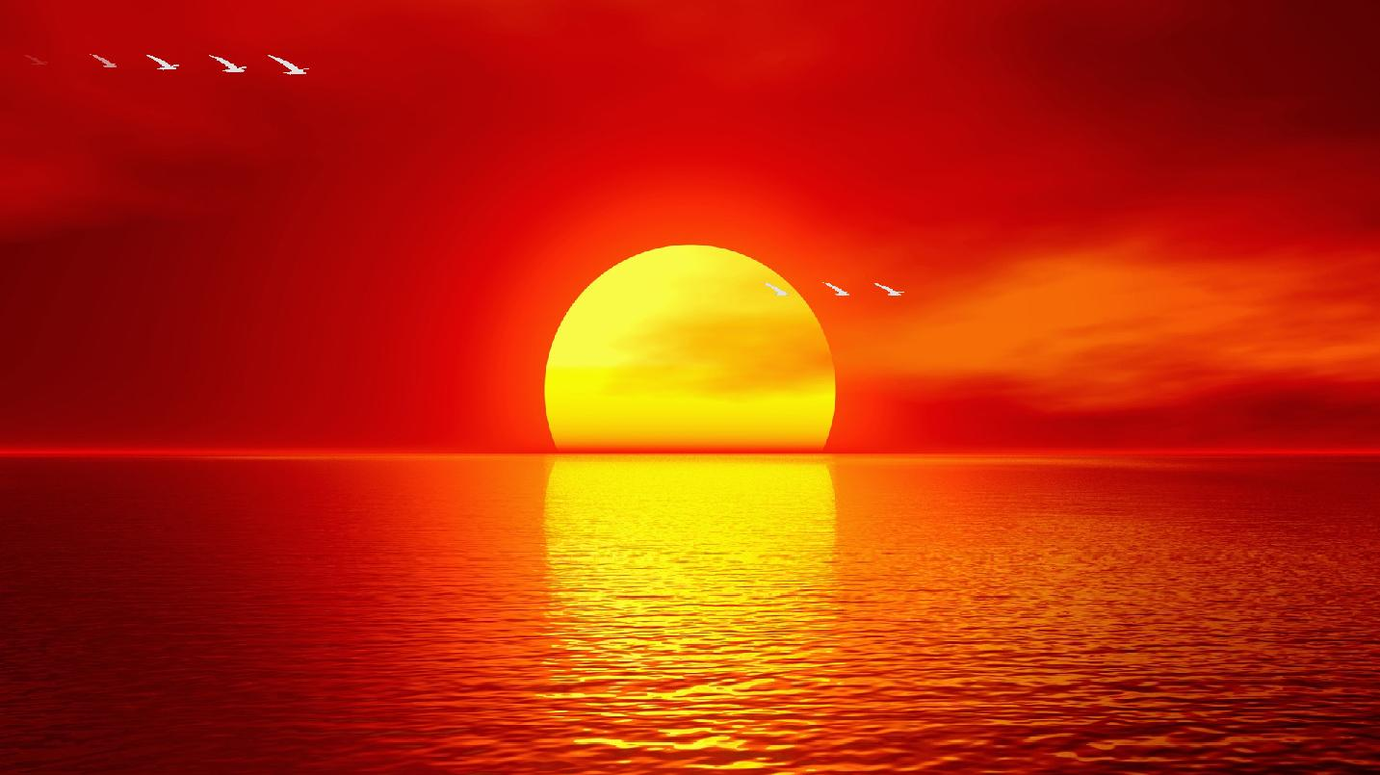
Thank You, SUN
Notes:
Thank you
http://static.wixstatic.com/media/815f40_544fc9d1275c43aaab3c79357a232554.gif

